Slide 1
WEB APPLICATION DEVELOPMENT
GUIDED BY : NALINA MA’AM
NAME | USN
ROOPESH REDDY C | 1BM19IS132
RAJATH K | 1BM19IS125
ROHITH KASHYAP | 1BM19IS131
DATE: 28/01/2021

Slide 2

AIM
TO DESIGN AN E-COMMERCE WEBSITE
PURPOSE OF AN E-COMMERCE WEBSITE
The online sellers can get a wide range of customers from around the globe.
The seller and the consumer can interact with each other regarding the products or services.
The consumers can get the details of the product you sell and your brand story (if you have invested your time in marketing).
Consumers can purchase online from anywhere at any time using your ecommerce website.
With the use of cookies, you can collect consumer data including the demographics that can be used for target marketing.
Including a feedback form can help you get direct feedback from your customers.
A website can help you in creating brand authenticity and consumer trust.

Slide 3

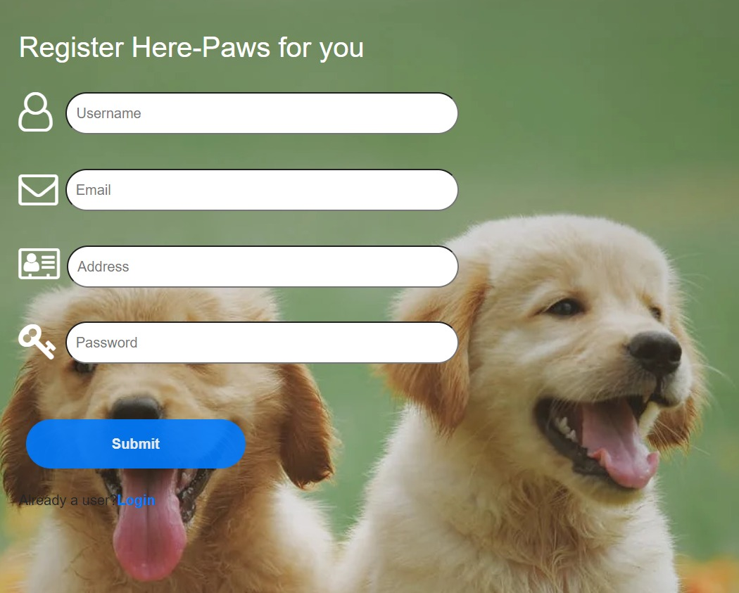
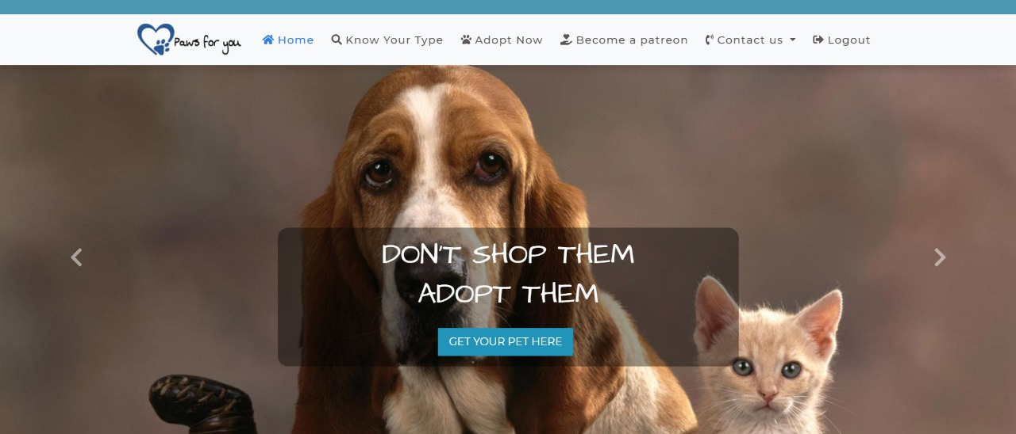
OBJECTIVE
TO DESIGN AN INTERACTIVE WEBSITE FOR ADOPTION OF PETS.

Slide 4
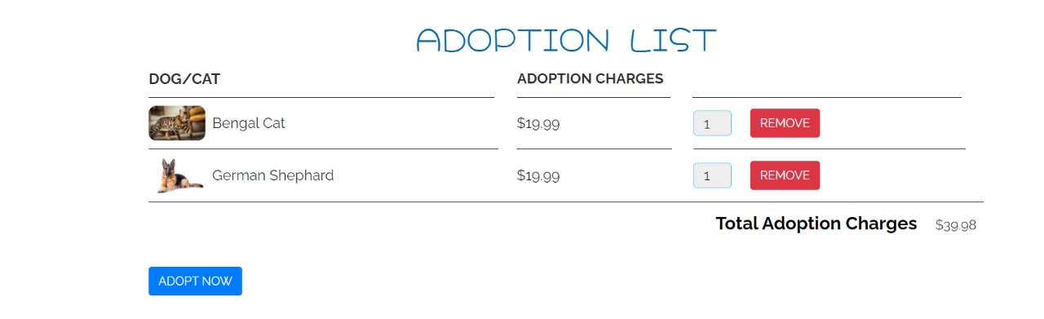
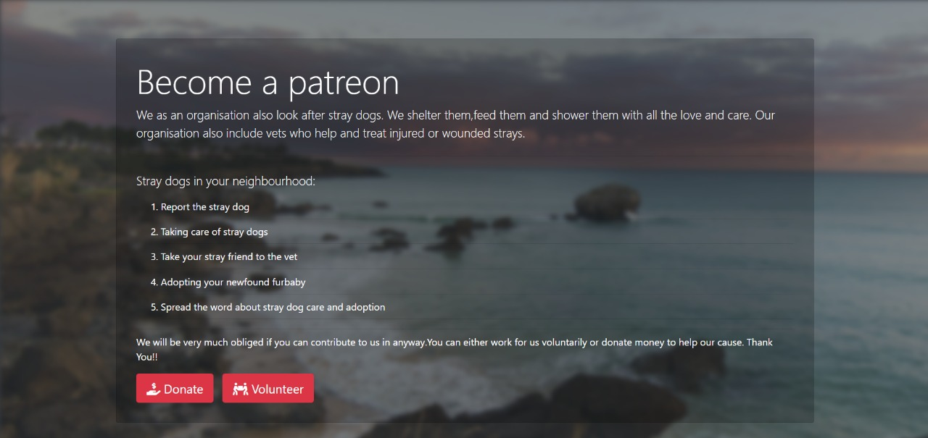
RESULT

Slide 5
CONCLUSION
LEARNT THE BASICS OF HTML AND CSS.
BRUSHED THROUGH THE TOPICS OF JAVASCRIPT.
IMPLEMENTED BASICS OF PHP AND MYSQL.
IMPORTANCE OF BOOTSTRAP OBSERVED.
USED BASICS TO DEVELOP A BASIC E-COMMERCE WEBSITE.

Slide 6
Thank you

